Slide 1







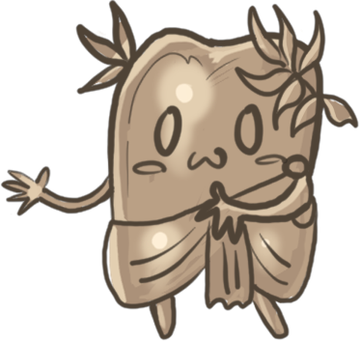
Pew Pew Battle Colosseum
Toastboat Games
Amazing 2D PvP Shooter Action

Slide 2







Vision Statement
Pew Pew Battle Colosseum is a funny 2D PvP Shooter in a distinct Comic Book style space colosseum. Use the recoil of your weapon to navigate the level and shoot your opponents.

Slide 3
Additional Information
Genre: 2D PvP Shooter
Platform: PC
2-4 Players
Input: X-Box Controller
Couch PvP / Party Game
Engine: Unity

Slide 4










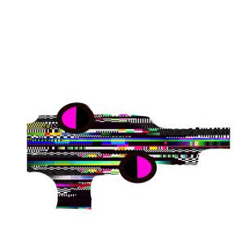











The Contestants are ready Let‘s fight

Slide 5
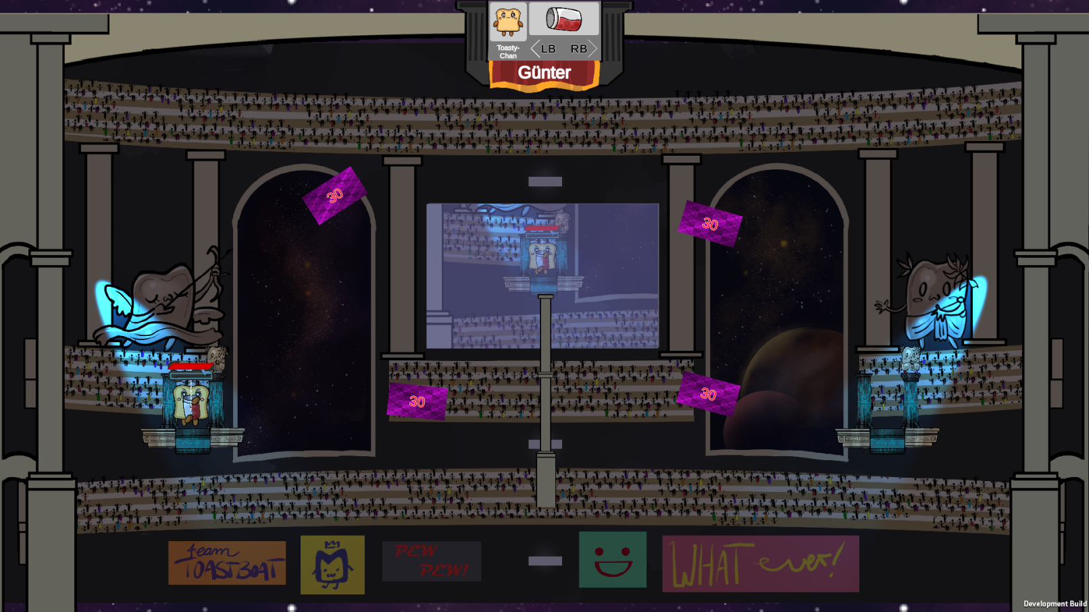
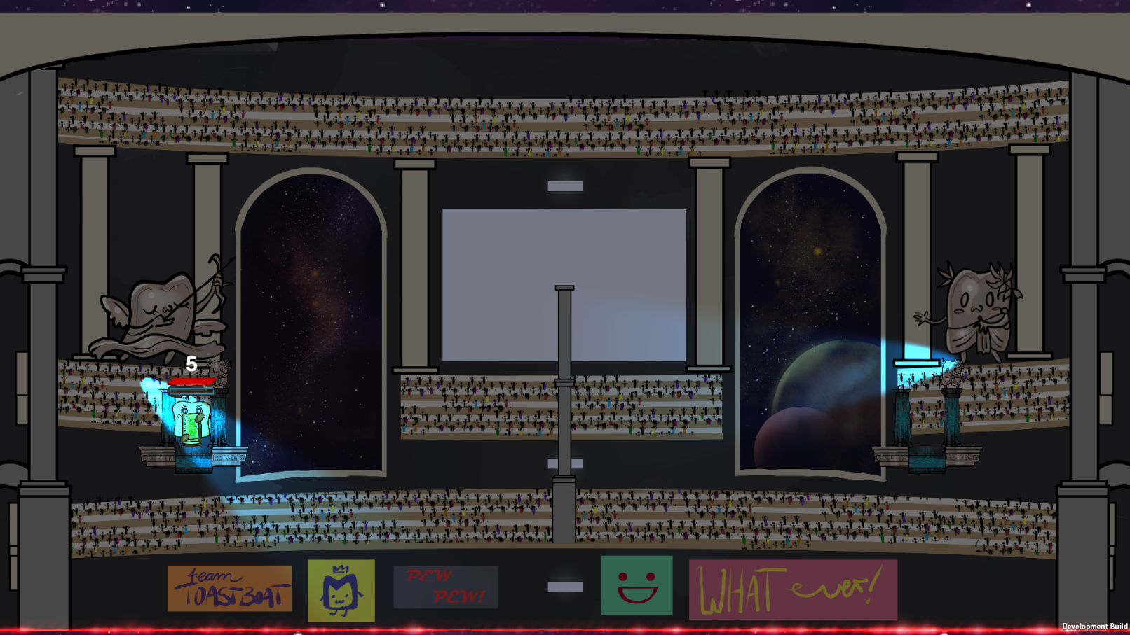
[WIP] Adjustments

Slide 6






New Characters

Slide 7
Feedback

Slide 8
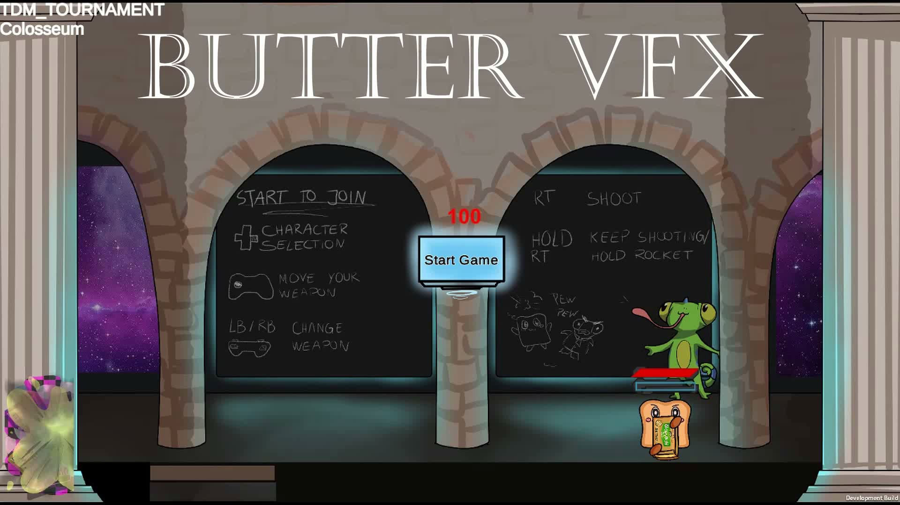
[WIP] Änderungen

Slide 9
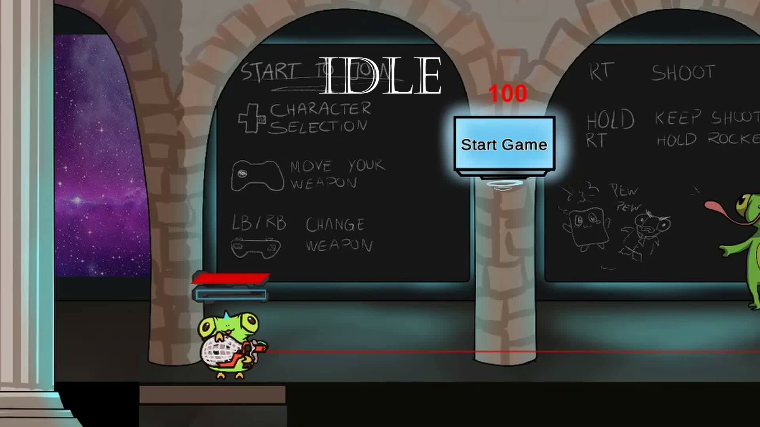
Animations
(By Laura Lückemeyer and Lisa-Marie Albrecht)

Slide 10
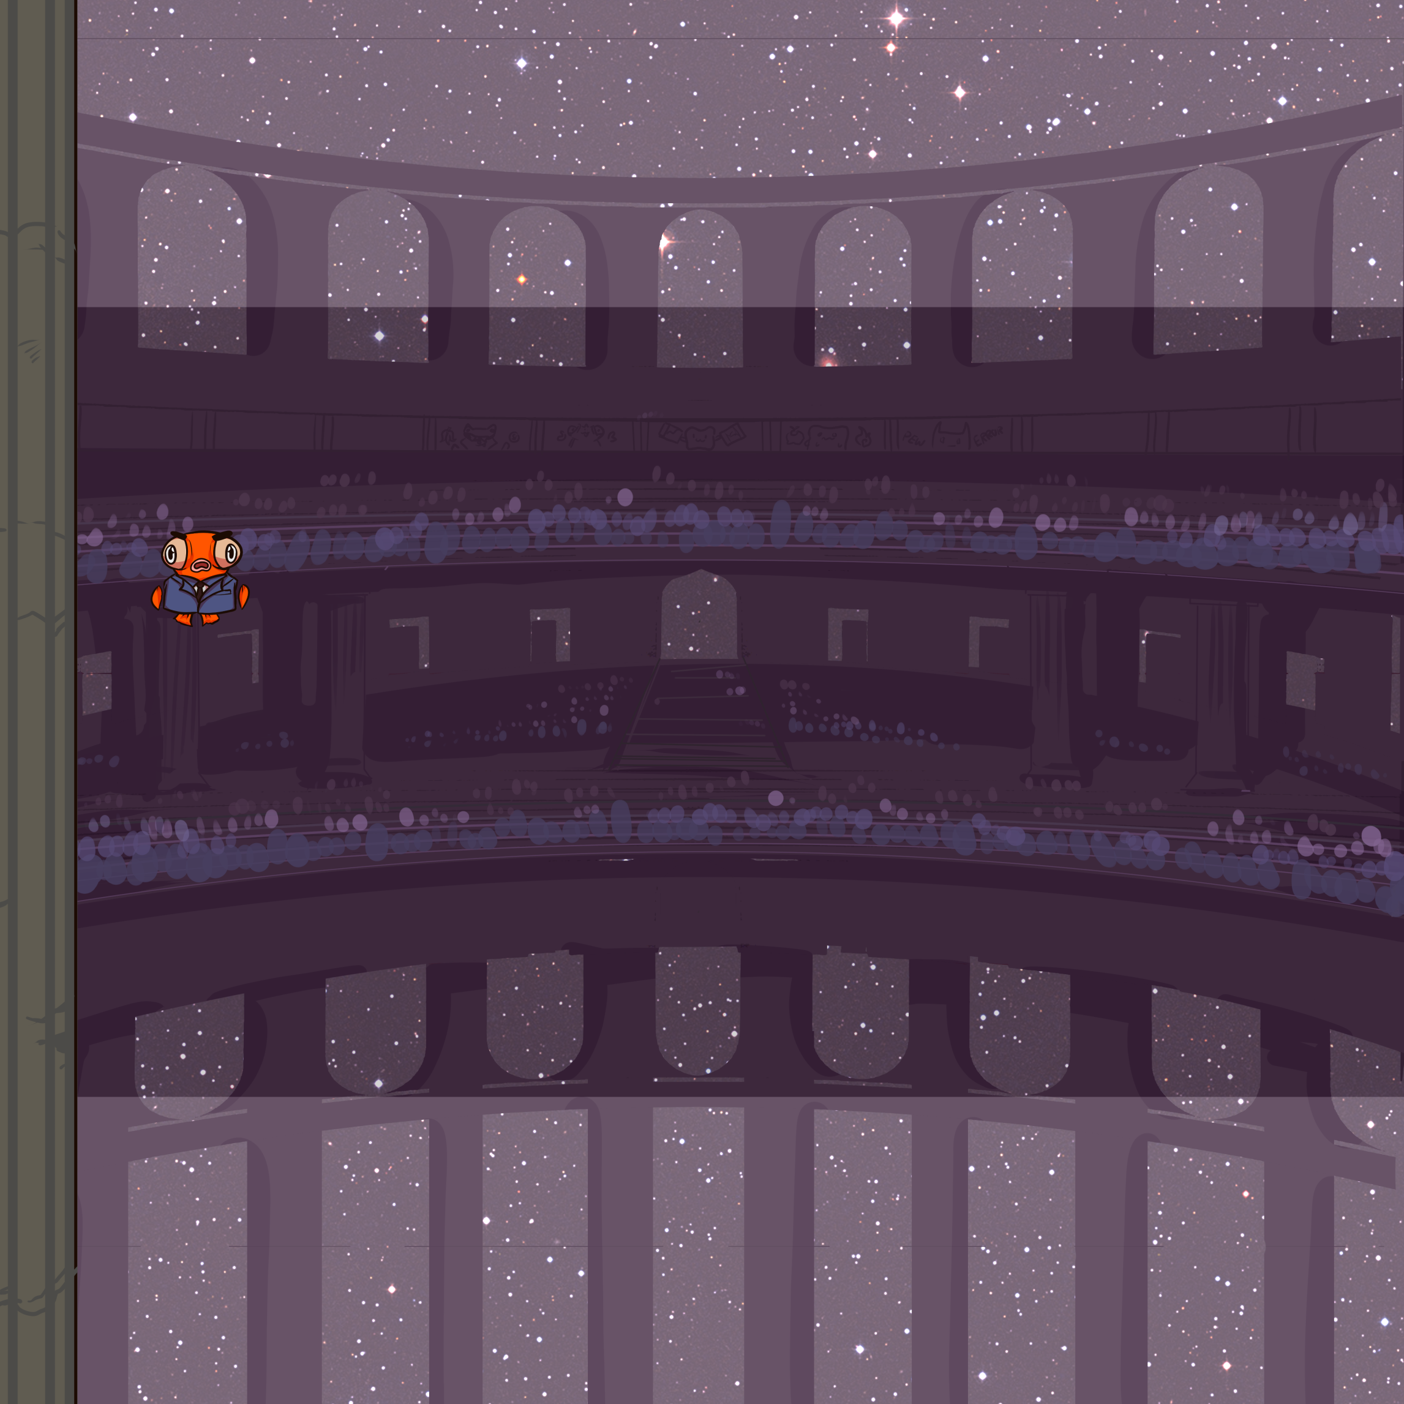
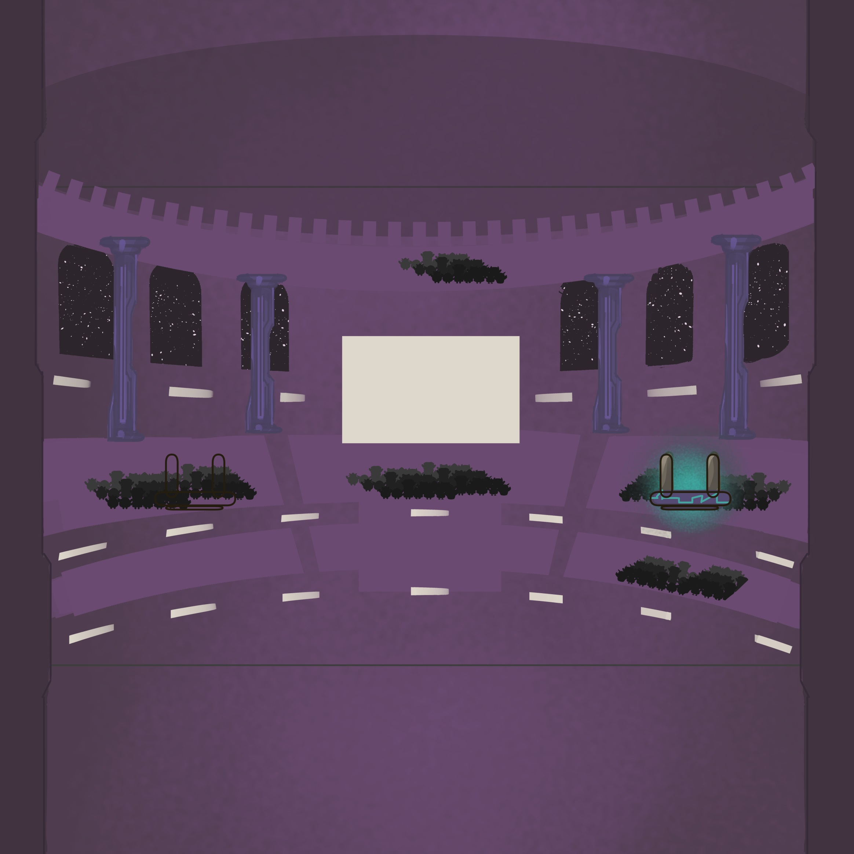
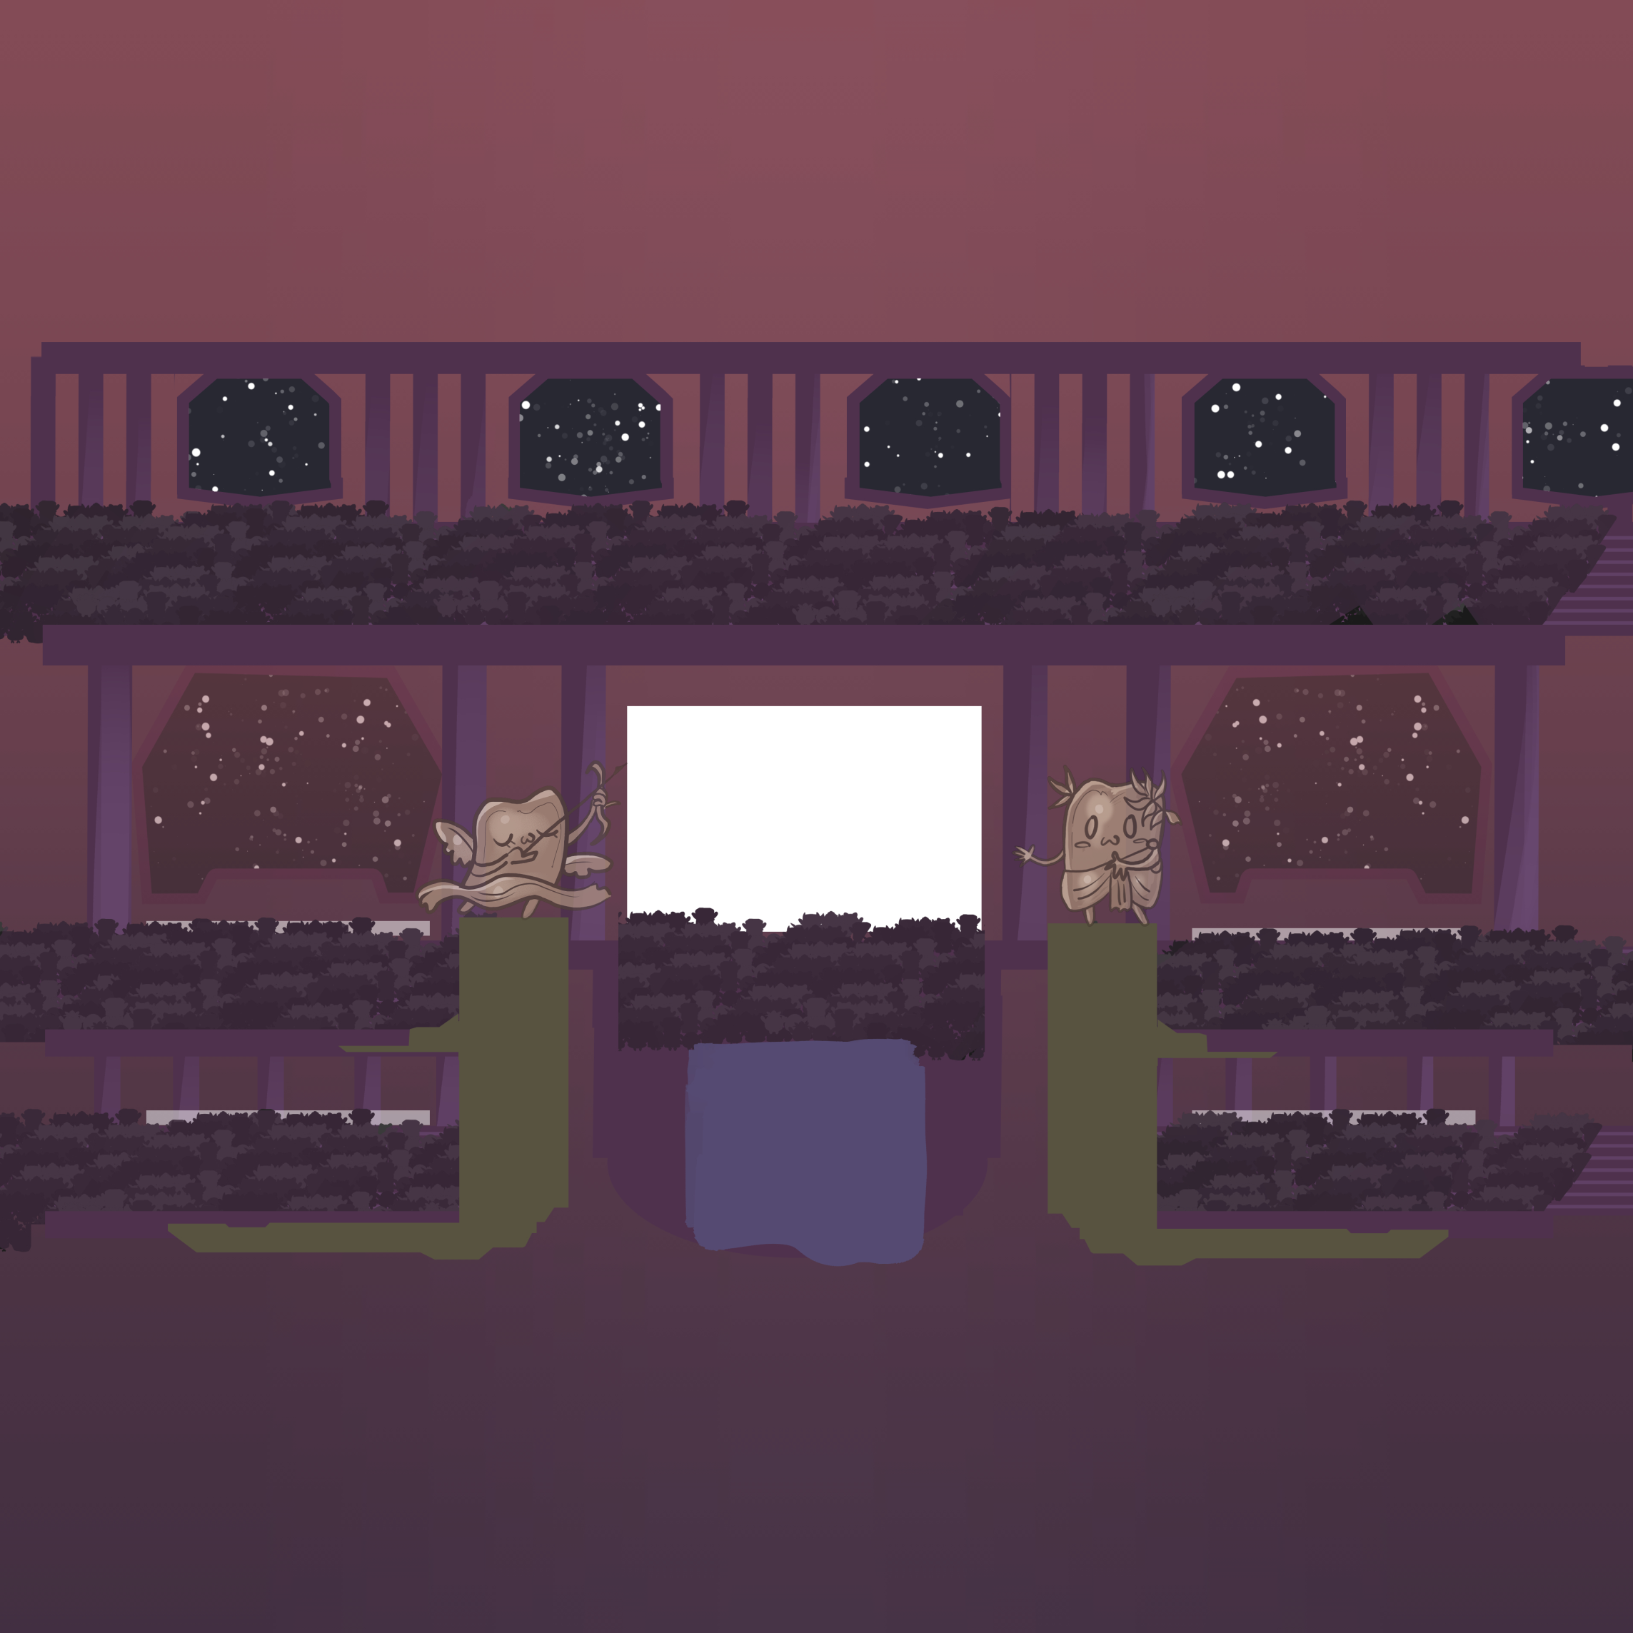

Environment

Slide 11
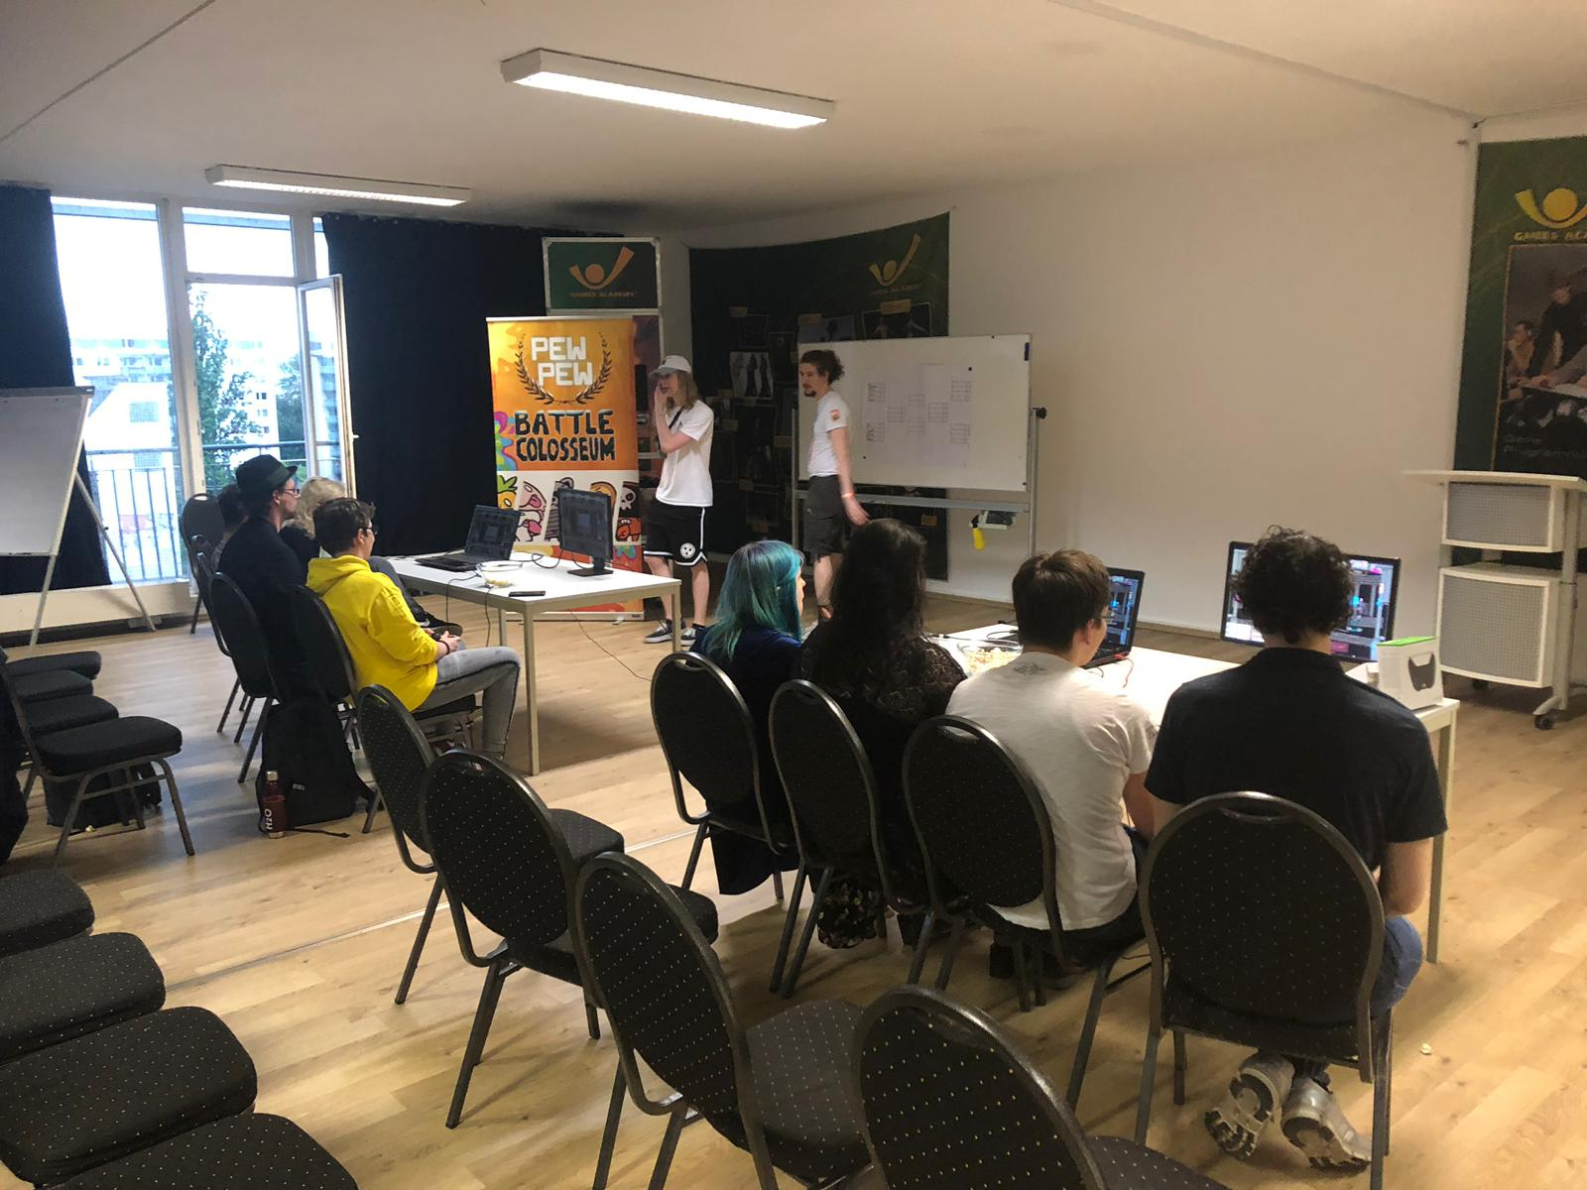
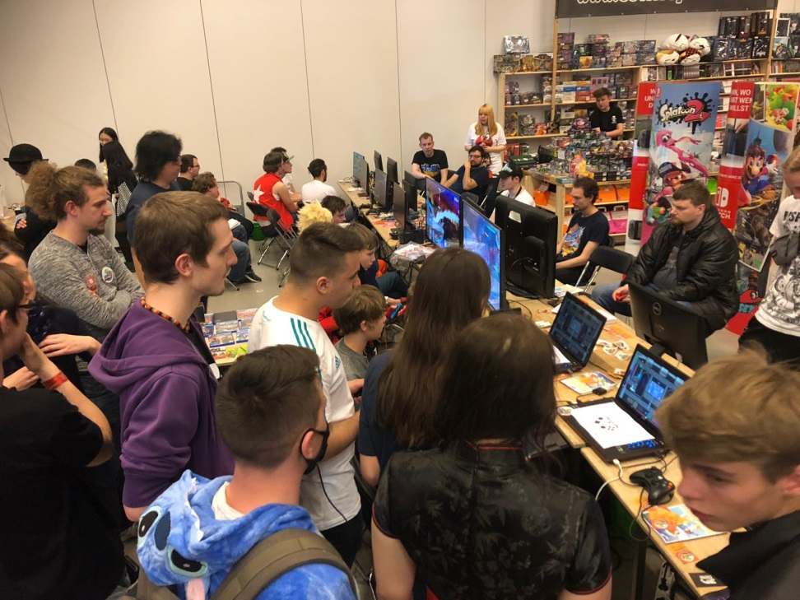
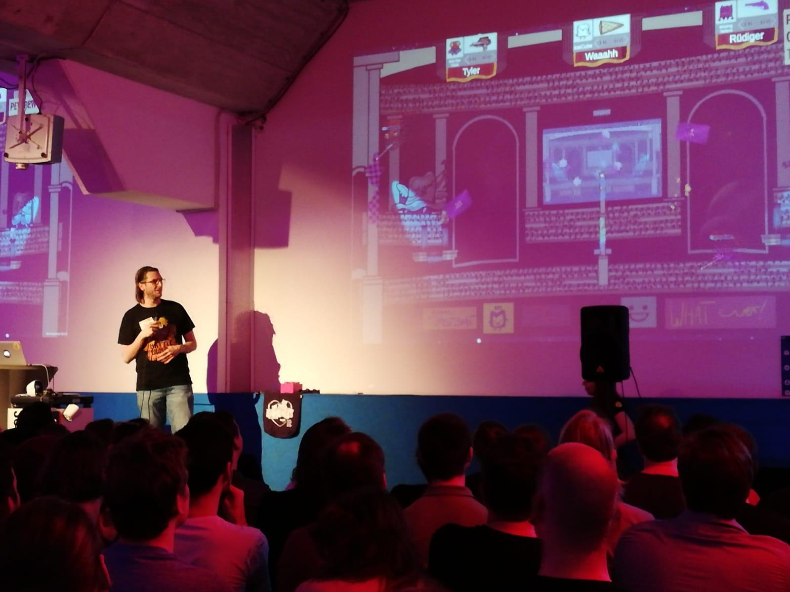
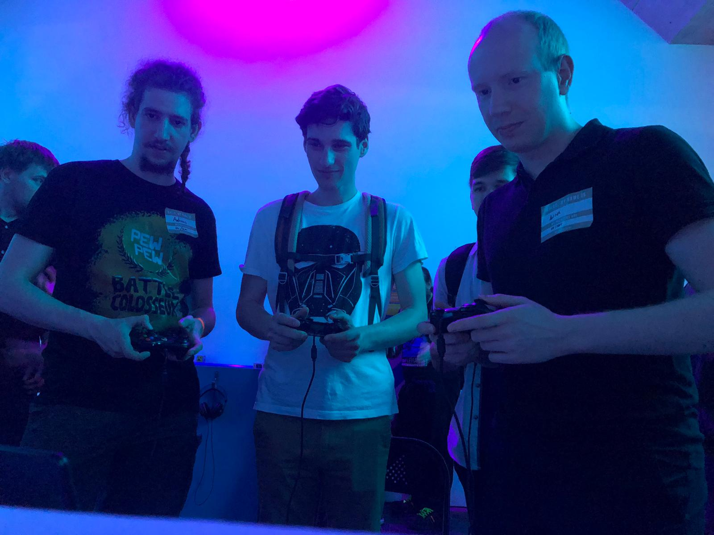
Pew Pew on the Road

Slide 12



Pew Pew on the road
5 Days
106 Players
/Pew.ToastboatGames
@ToastboatG
324 Matches
discord.gg/uSSNbjn

Slide 13


Gate 1
Refine Core Gameplay
Arena Background
Implement Hazards
Feedback
Focus on Characters
Extensive QA
Animations
Establish Social Media Presence

Slide 14
Gate 2
Menu flows
More Feedback
New Gamemode
Extensive QA
Refine exitsting Gamemodes
Further promote the game in public

Slide 15





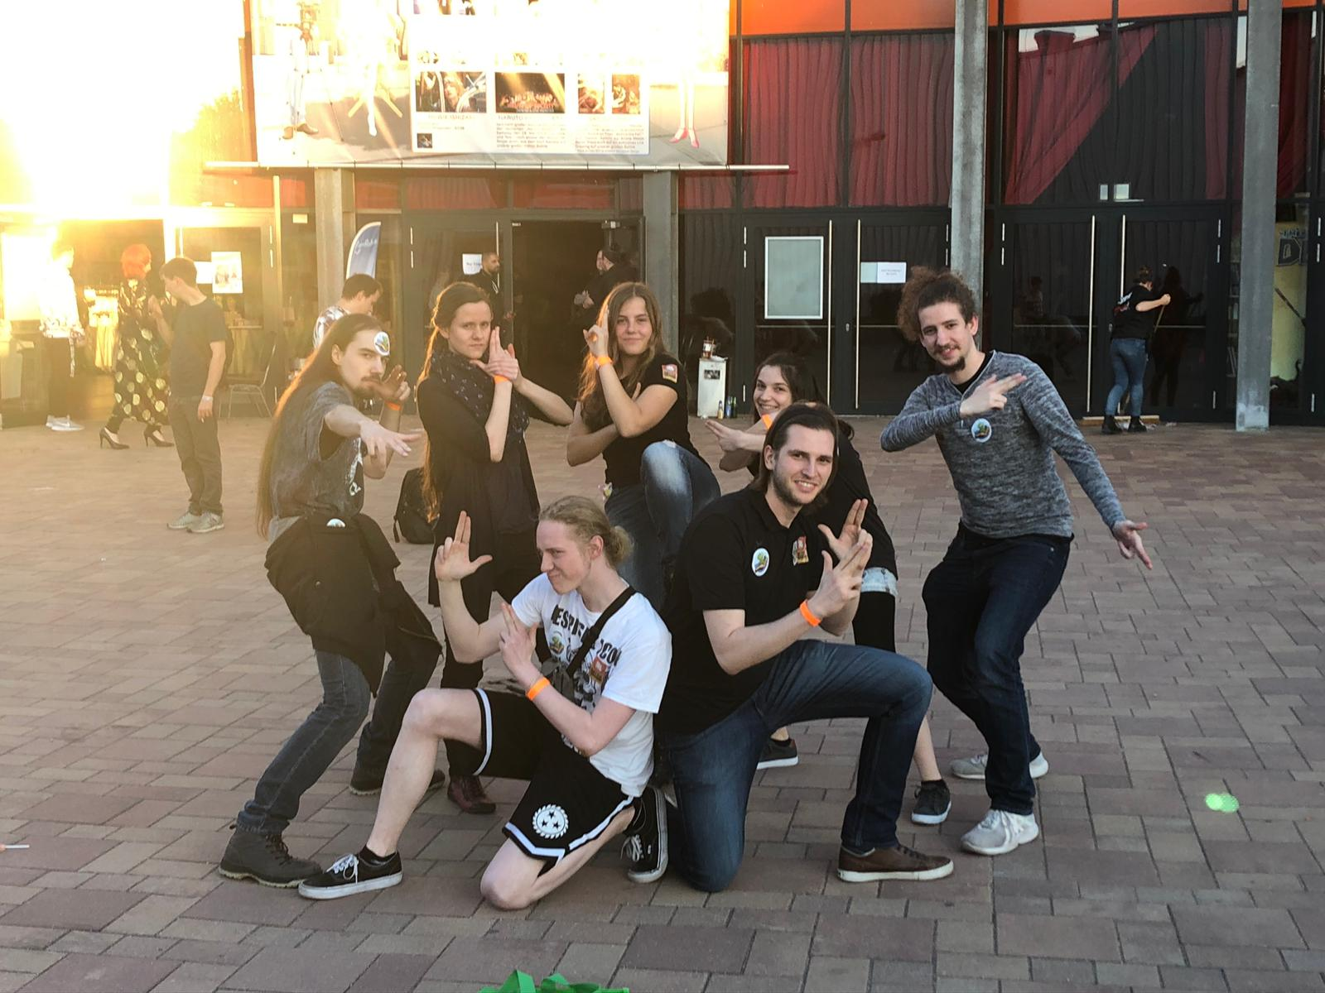
Team
Pew Pew Battle Colosseum
Max Raabe
Raoul Seresse
Raoul Seresse
Benjamin Feder
Caterina Wölfle
Laura Lückemeyer
Lisa-Marie Albrecht
Paul Schuldt
Andreas Edmeier
Max Raabe

